Slide 1
Garbage Disposal System for Smart Cities
Under the mentorship of: Dr. Bibhudatta Sahoo
By: Ashish Kumar (112CS0155) & Chinmaya Dehury (112CS0560)

Slide 2
350*
*Million tonne of garbage is
generated by a thriving 1.6 billion population every year [7]

Slide 3
Motivation
Owing to the development, the garbage generation in the cities is increasing manifold.
World Bank estimates that roughly 3 billion urban residents generated an average 1.2 billion kg per capita per day [7].
With the advent of smart cities, we can now model a modern GDS that can take the advantage of the facilities that the smart cities has to offer.

Slide 4
Motivation
As the smart city flourishes, we will have more Internet Access Point across the city and we can have IoT enabled devices to monitor the garbage.
In the future smart cities will grow in size, IoT devices can be moved to the cloud where it can be scaled easily.

Slide 5
Achievements
We have successfully designed a prototype to monitor the waste bins in real time.
This helped us in achieving a Quality of Service i.e. to minimize the spillage of wastes from the bins.
A solution to address the battery-replacement problem is introduced.
Moreover, using the data collected from prototype we can schedule the pick up trucks to minimize the fuel capital expenditure.

Slide 6
Problem Statement
Fill level measurement
To measure the fill value inside the bin at real time and to communicate this data to the server for further processing.
Route Planning

For scheduling the garbage collector based on the real time data, so that no pick-up trip is wasted or under utilized.
Battery Replacement

To decide when the battery is to be replaced, inside the sensor.

Slide 7
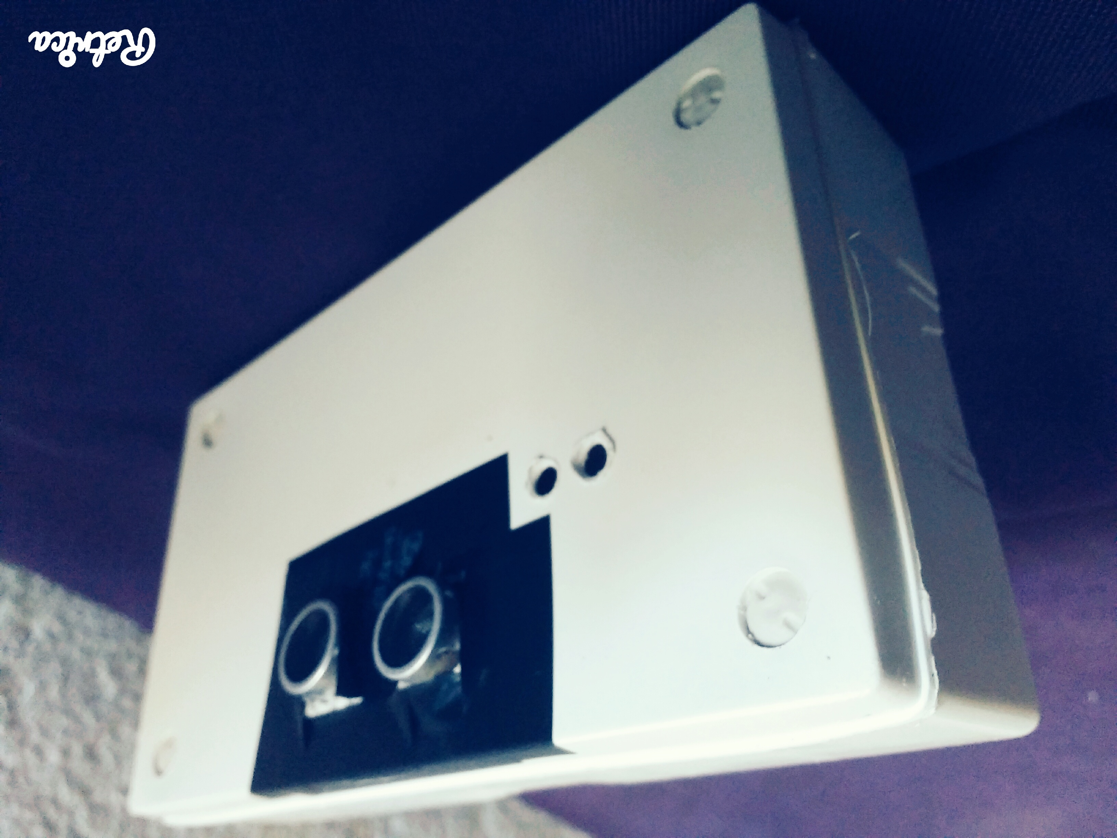
Final Prototype
Setbacks of the last prototype
The previous prototype had everything we desired but it was bulky, occupied space, delicate and vulnerable to damage at the slightest misfortune, so we decided to set up the components in a PVC box.

Slide 8
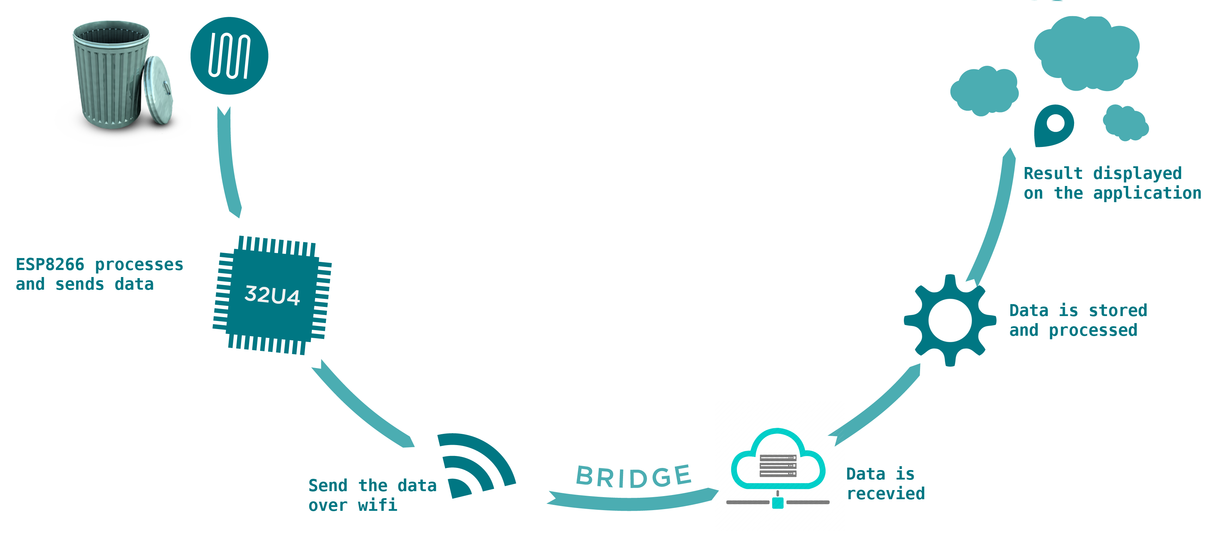
Flow chart of the process
Back

Slide 9
Routing pick up
Flag the bins.
Using the direction service to plot the route.
Optimize the waypoints using API.

Slide 10
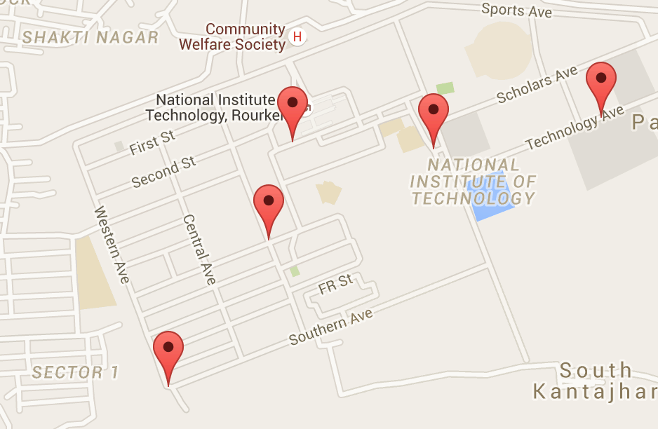
Finding and Visualizing the Shortest Path
Flag the bins
Step 1
The bins whose filled value crosses the threshold are flagged. Since we already know the locations of these bins, they are marked on the map as shown.
Here in the above picture, we have selected five locations inside the institute to illustrate the first step of flagging the bins.

Slide 11
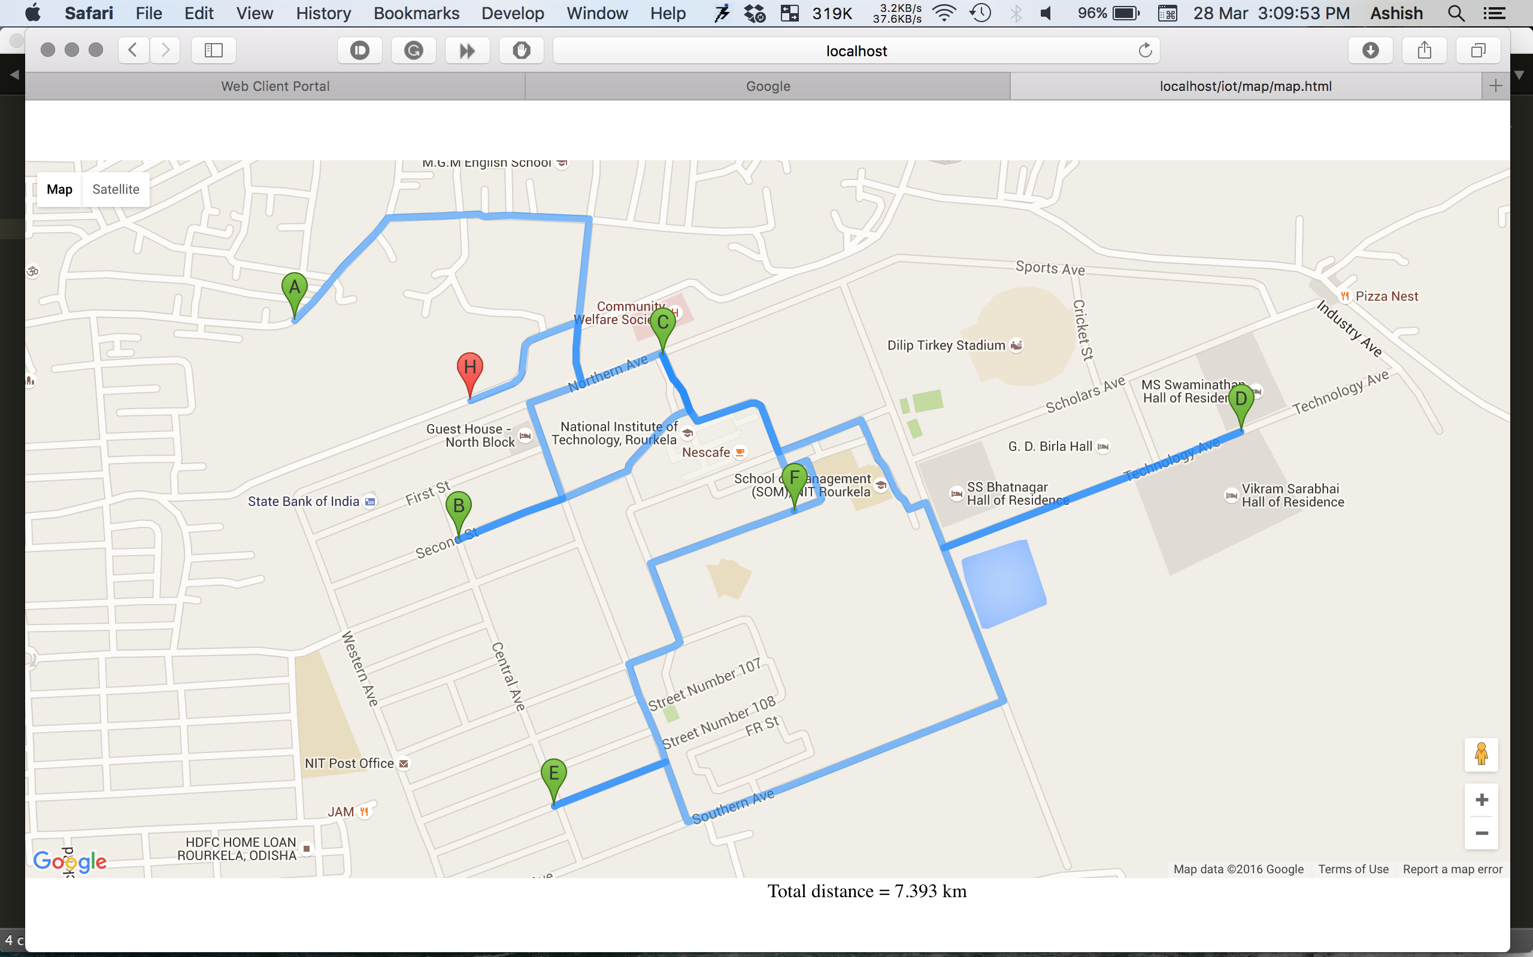
Finding and Visualizing the Shortest Path
Step 2
Plot the route [Non optimized trip distance (NOTD)= 7.393 km]
Co-ordinates are given as input to the Maps API, and for optimization we pass this input as a parameter to a routing function and it’s result is displayed by the APIs direction service.

Slide 12
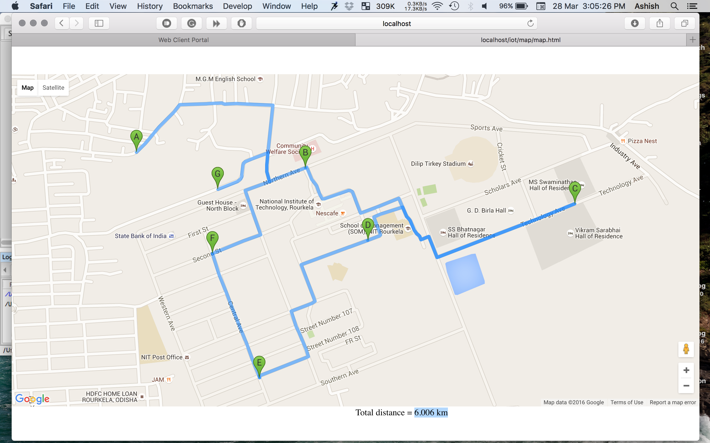
Finding and Visualizing the Shortest Path
Step 3
Optimized Route [Optimized Trip Distance (OTD) = 6.006 km]
Co-ordinates are given as input to the Maps API, and for optimization we pass this input as a parameter to a routing function with the waypointOptimize value set as true and it’s result is displayed by the APIs direction service.

Slide 13
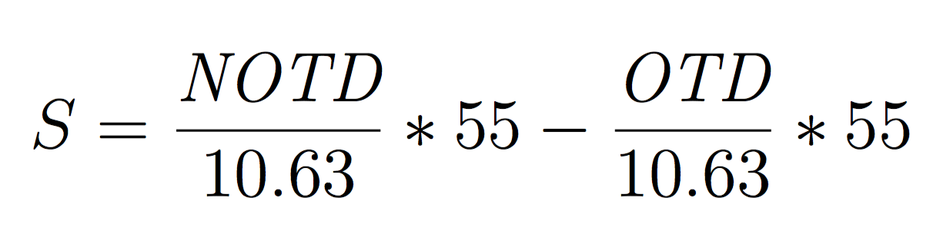
Fuel Cost Optimization
S => Savings
SP=> Saved Percentage
S = ((7.393 – 6.006)/10.63)*55 = 7.176
SP = 19%

Slide 14
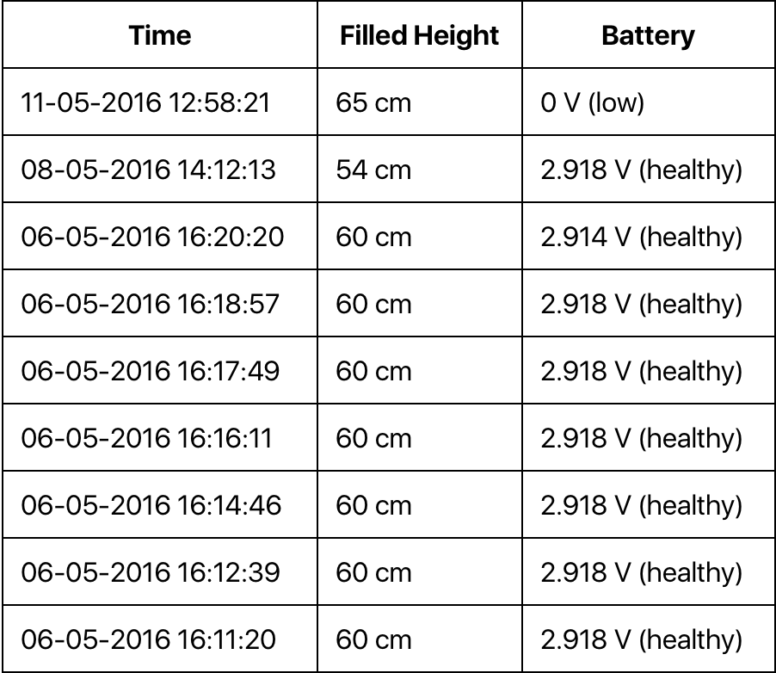
Battery Health Monitor
90%
35%
Healthy
Low!
Condition Specification
Condition Specification
When voltage at the terminal is greater than or equal to 2.8V
When voltage at the terminal is less than 2.8V
Round chart description:
The NodeMCU provides a service to monitor the voltage at the terminal using the function node.readvdd33().

Slide 15
Data Interpretation
Ways to use the obtained data
100%
80%
83%
90%
80%
68%
70%
60%
55%
50%
52%
50%
30%
0%
2016
2017
2018
2019
2020
2021
2022
2023
2024
Data can be used to establish a “Decision Support System”
Such a system will tell us based on the data if we have to add more truck to the system or to add more bins, just by analyzing the data. It will also help in scaling the GDS to much wider cities.

Slide 16
Future Works
The data collected over the years can be used by the Municipal Corporation to set a budget for MSW in a year in advance.
It can used to determine the place where the bins are to be located to maximize our Quality of Service i.e. to minimize the spillage.
Based on the data we can also determine the possible locations of the trucks so that they arrive on time for the pick up to maximize the effectiveness of the system.
Provide on-demand along with the on-routine services with a dedicated mobile app for all the platforms.
Use of RFID modules to categorize the wastes into different segments like organic, plastic, metal wastes, etc.
Change routes dynamically to avoid traffic, roadblocks and to save time.

Slide 17
Conclusion
Garbage Disposal System for smart cities is a small but important step forward
in automating the garbage collection process. This project portrays the utilization
of our model of Smart Bin in dealing with the waste accumulation arrangement
of a whole city. The system of sensors empowered smart bins connected through
the IoT system creates a large amount of data, which is further investigated and
analyzed at in real time to gather information about the status of waste around
the city.

Slide 18
Bibliography
Timing Diagram HC-SR04, “Open Electronics Project”. Openelectronicsproject.in . N.p., 2015. Web. 10 Feb. 2016.
Adrian McEven, Hakim Cassimally Designing Internet of Things. Wiley, 1st edition, 2014.
http://esp8266.co.uk information regarding ESP8266.
http://nodemcu.com/ information regarding the firmware.
IoT-Based Smart Garbage System for Efficient Food Waste Management (Research Article) Insung Hong, Sunghoi Park, Beomseok Lee, Jaekeun Lee, Daebeom Jeong, and Sehyun Park School of Electrical and Electronics Engineering, Chung-Ang University, Seoul 151-756, Republic of Korea .
International Journal of Scientific & Engineering Research, Volume 6, Issue 9, September-2015. Smart Bin Implementation for Smart Cities , Narayan Sharma, Nirman Singha, Tanmoy Dutta .
Mackinnon Lawrence, Eric Woods. Advanced Collection, Processing, Energy Recovery, and Disposal Technologies for the Municipal Solid Waste Value Chain: Global Market Analysis and Forecasts, Navigant Research,second quarter 2014.

Slide 19
Flow chart of the process
Back

Slide 20
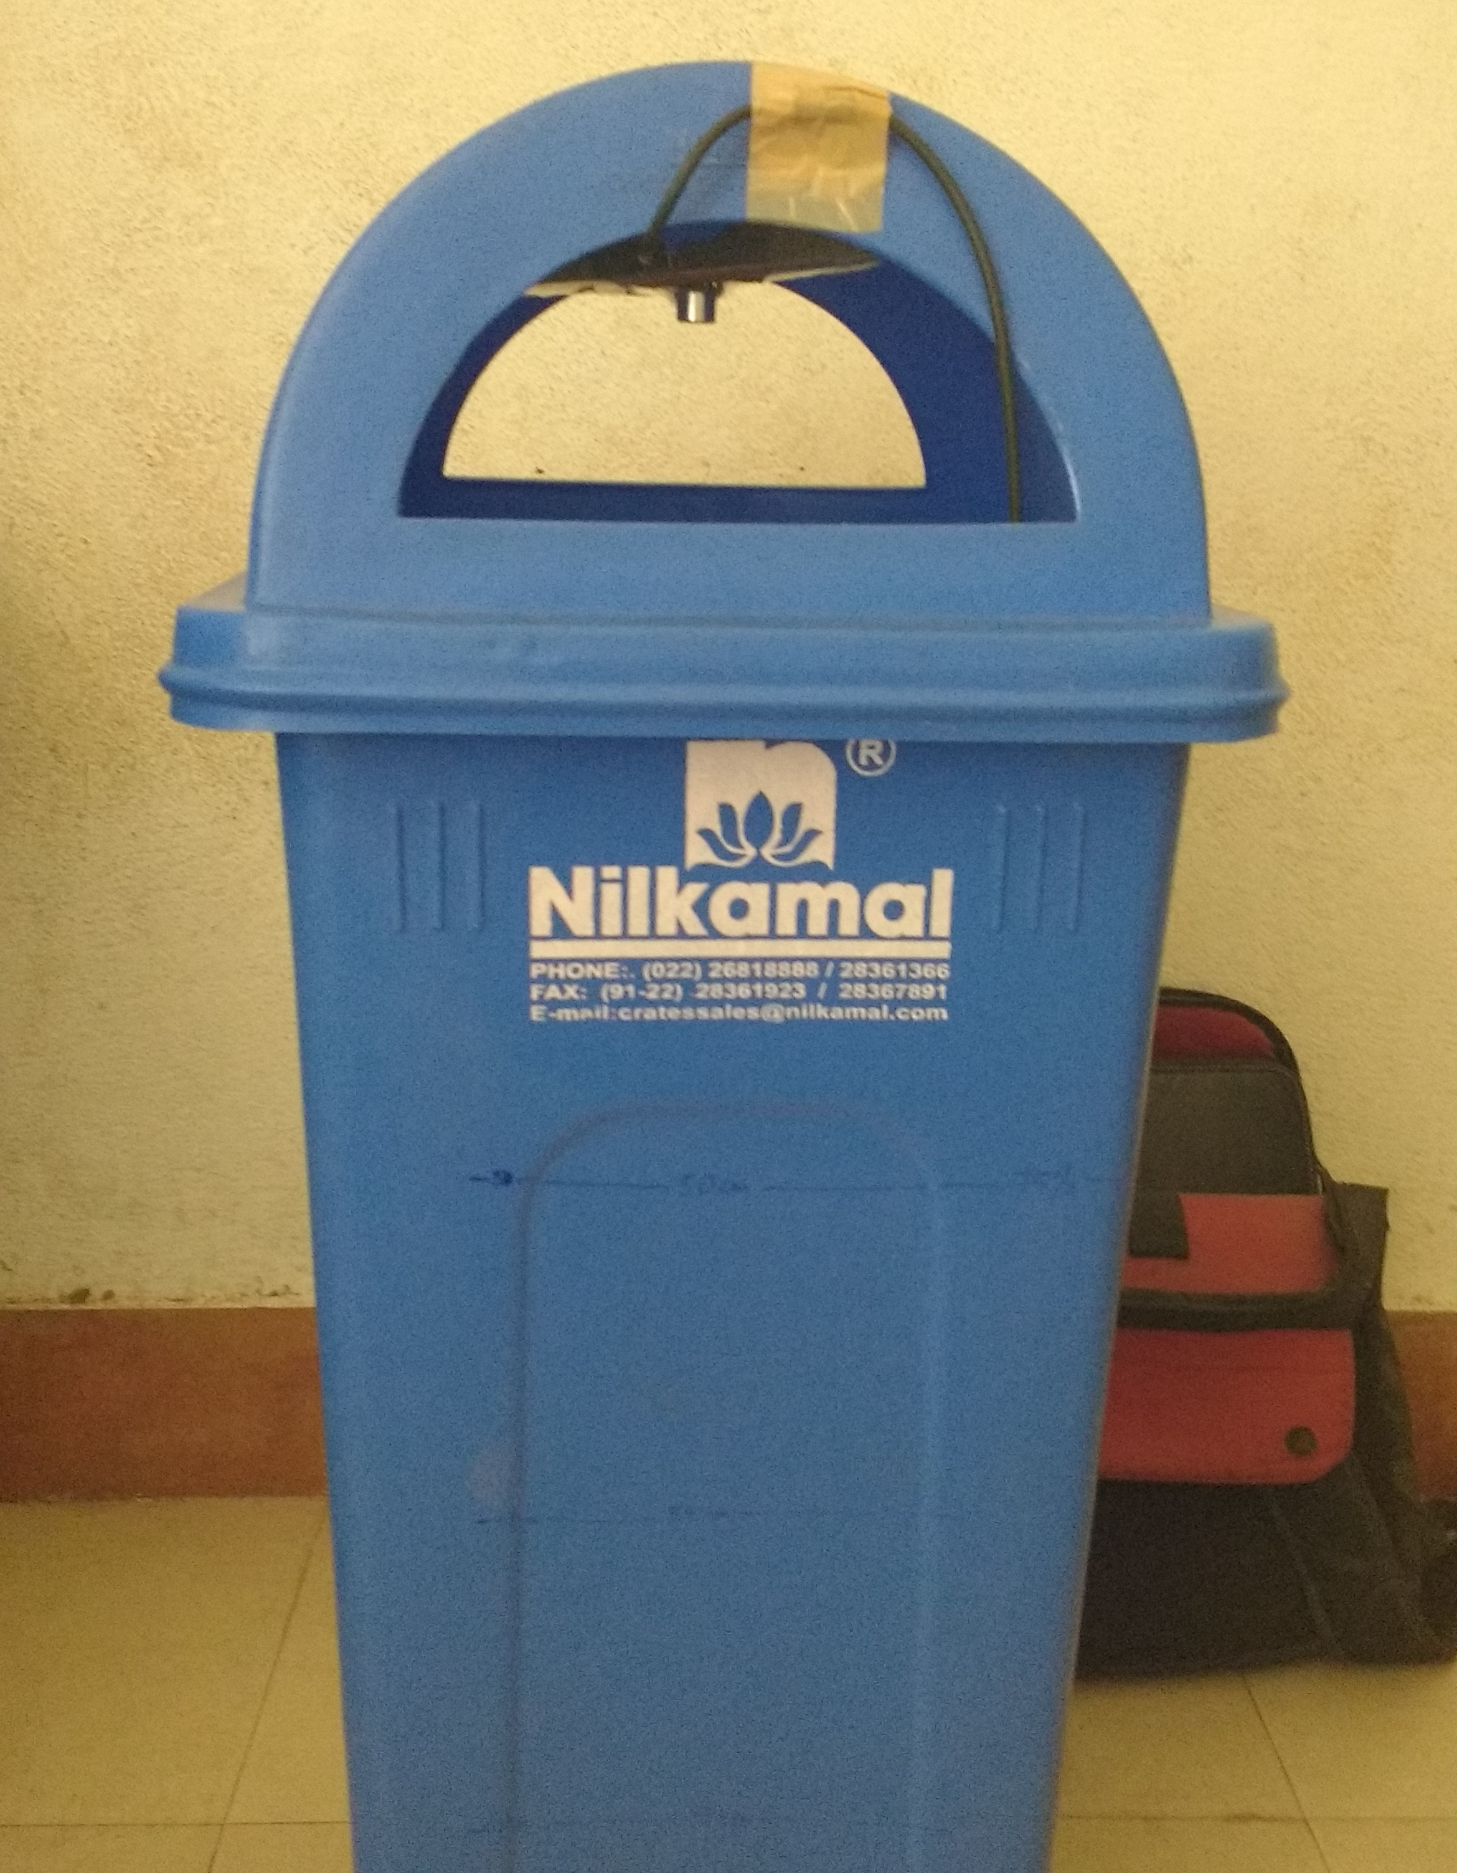
Last Semester
Phase - 2
Wired Prototype
Feasibility Study
Using Arduino Uno and HCSR-04, I made a prototype that could measure the fill level of the bin, the data was being sent via a USB – cable to my system, which the python & CGI-driven application would pick-up and based on its processing would display the result in a neat web interface. After building this prototype it was clear to me now that wireless prototype would be feasible, but it depended on selecting the right components to full-fill my requirements on its integration.
Back
Source : Self-taken

Slide 21
Design Challenges
In Phase – 3 (Wireless Prototype)
3.1 Selecting the right microcontroller (MCU)
3.2 Providing a stable power source
3.3 Flashing the right firmware
3.4 Interfacing HCSR-04
Back

Slide 22
1. Selecting right MCU
MCU - Microcontroller
In a world dominated with Arduino MCU’s, one has to really have patience to look for it’s alternative.
I was looking for something more compact but with the same level of sophistication and dependability.
Source : Self-compiled data from Literature Survey
Back

Slide 23
Choosing the right micro-controller(MCU) unit
Motivation: Less Power Consumption
Objective: Compact
The basic and most fundamental requirement for the MCU was to be compact and have a very minimal energy footprint so that it could last longer on batteries or any independent power source.
On comparison of various micro-controller units based on their size, power – consumption, size and other essential features that I required like encryption, TCP/IP Protocol, I arrived with the following result.
Literature Survey Observation
 | ESP-01 | Arduino | Raspberry Pi
Cost | ~ ₹200 | ₹800 - ₹2000 | ₹2500
Wifi | Built-in | Shield(₹3000)/ESP | USB Dongle
Sleep Current | <10 𝓾A | <1 𝓂A | <20 𝓂A
Size | 21 x 11 mm | 66 x 53 mm | 50 x 60mm
Wifi Standards | 802.11 b/g/n | 802.11 b/g | 802.11 b/g/n
Storage | Built-in | Built-in | External
Source : Compiled from various online resources
Back

Slide 24
The Right MCU
Literature Survey Result
ESP8266 wifi Module
Tiny but bit as powerful
SOC with integrated TCP/IP protocol
802.11 b/g/n
Low Cost
2+ GPIO pins
External Flash up to 4MB
Standby power consumption of <1.0mW (DTIM3)
No external RF components
Supports Bluetooth co-existence interface
Image Source : http://www.esp8266.co.uk
To simply put it: ESP8266 => MCU + GPIO + WIFI, TINY and SCRIPTABLE
and this is why it perfectly rhymed with my requirements and became my choice
Back

Slide 25
2. The problem with
Power Source
3.3V Experience
All about a stable voltage.
ESP8266 needs a perfectly stable input source, any fluctuation in the voltage in the order of 300mV causes it to abruptly restart.
Another problem was with the finding of the right voltage and baud rate at which the chip_enable would work without which all I ever got was garbage as output.
Source : Self-taken
The first problem was later solved temporarily but I was yet to find a better and stable source, however the second problem persisted long after the first problem was resolved, more-over I still think the second problem was related to the first one. I’ll explain all about it next.
Back

Slide 26
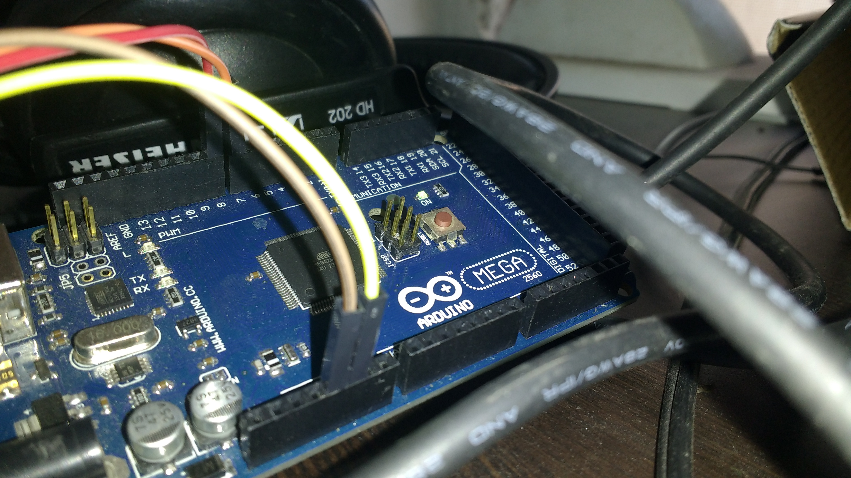
First Experiment
Observation - 1
I used an Arduino as the power-source because it has a 3.3V output pin. I knew this would power up the ESP but I was not going to use it later on, because it would take up more space and power and it had to be connected to an USB port.
Back
Source : Self-taken

Slide 27
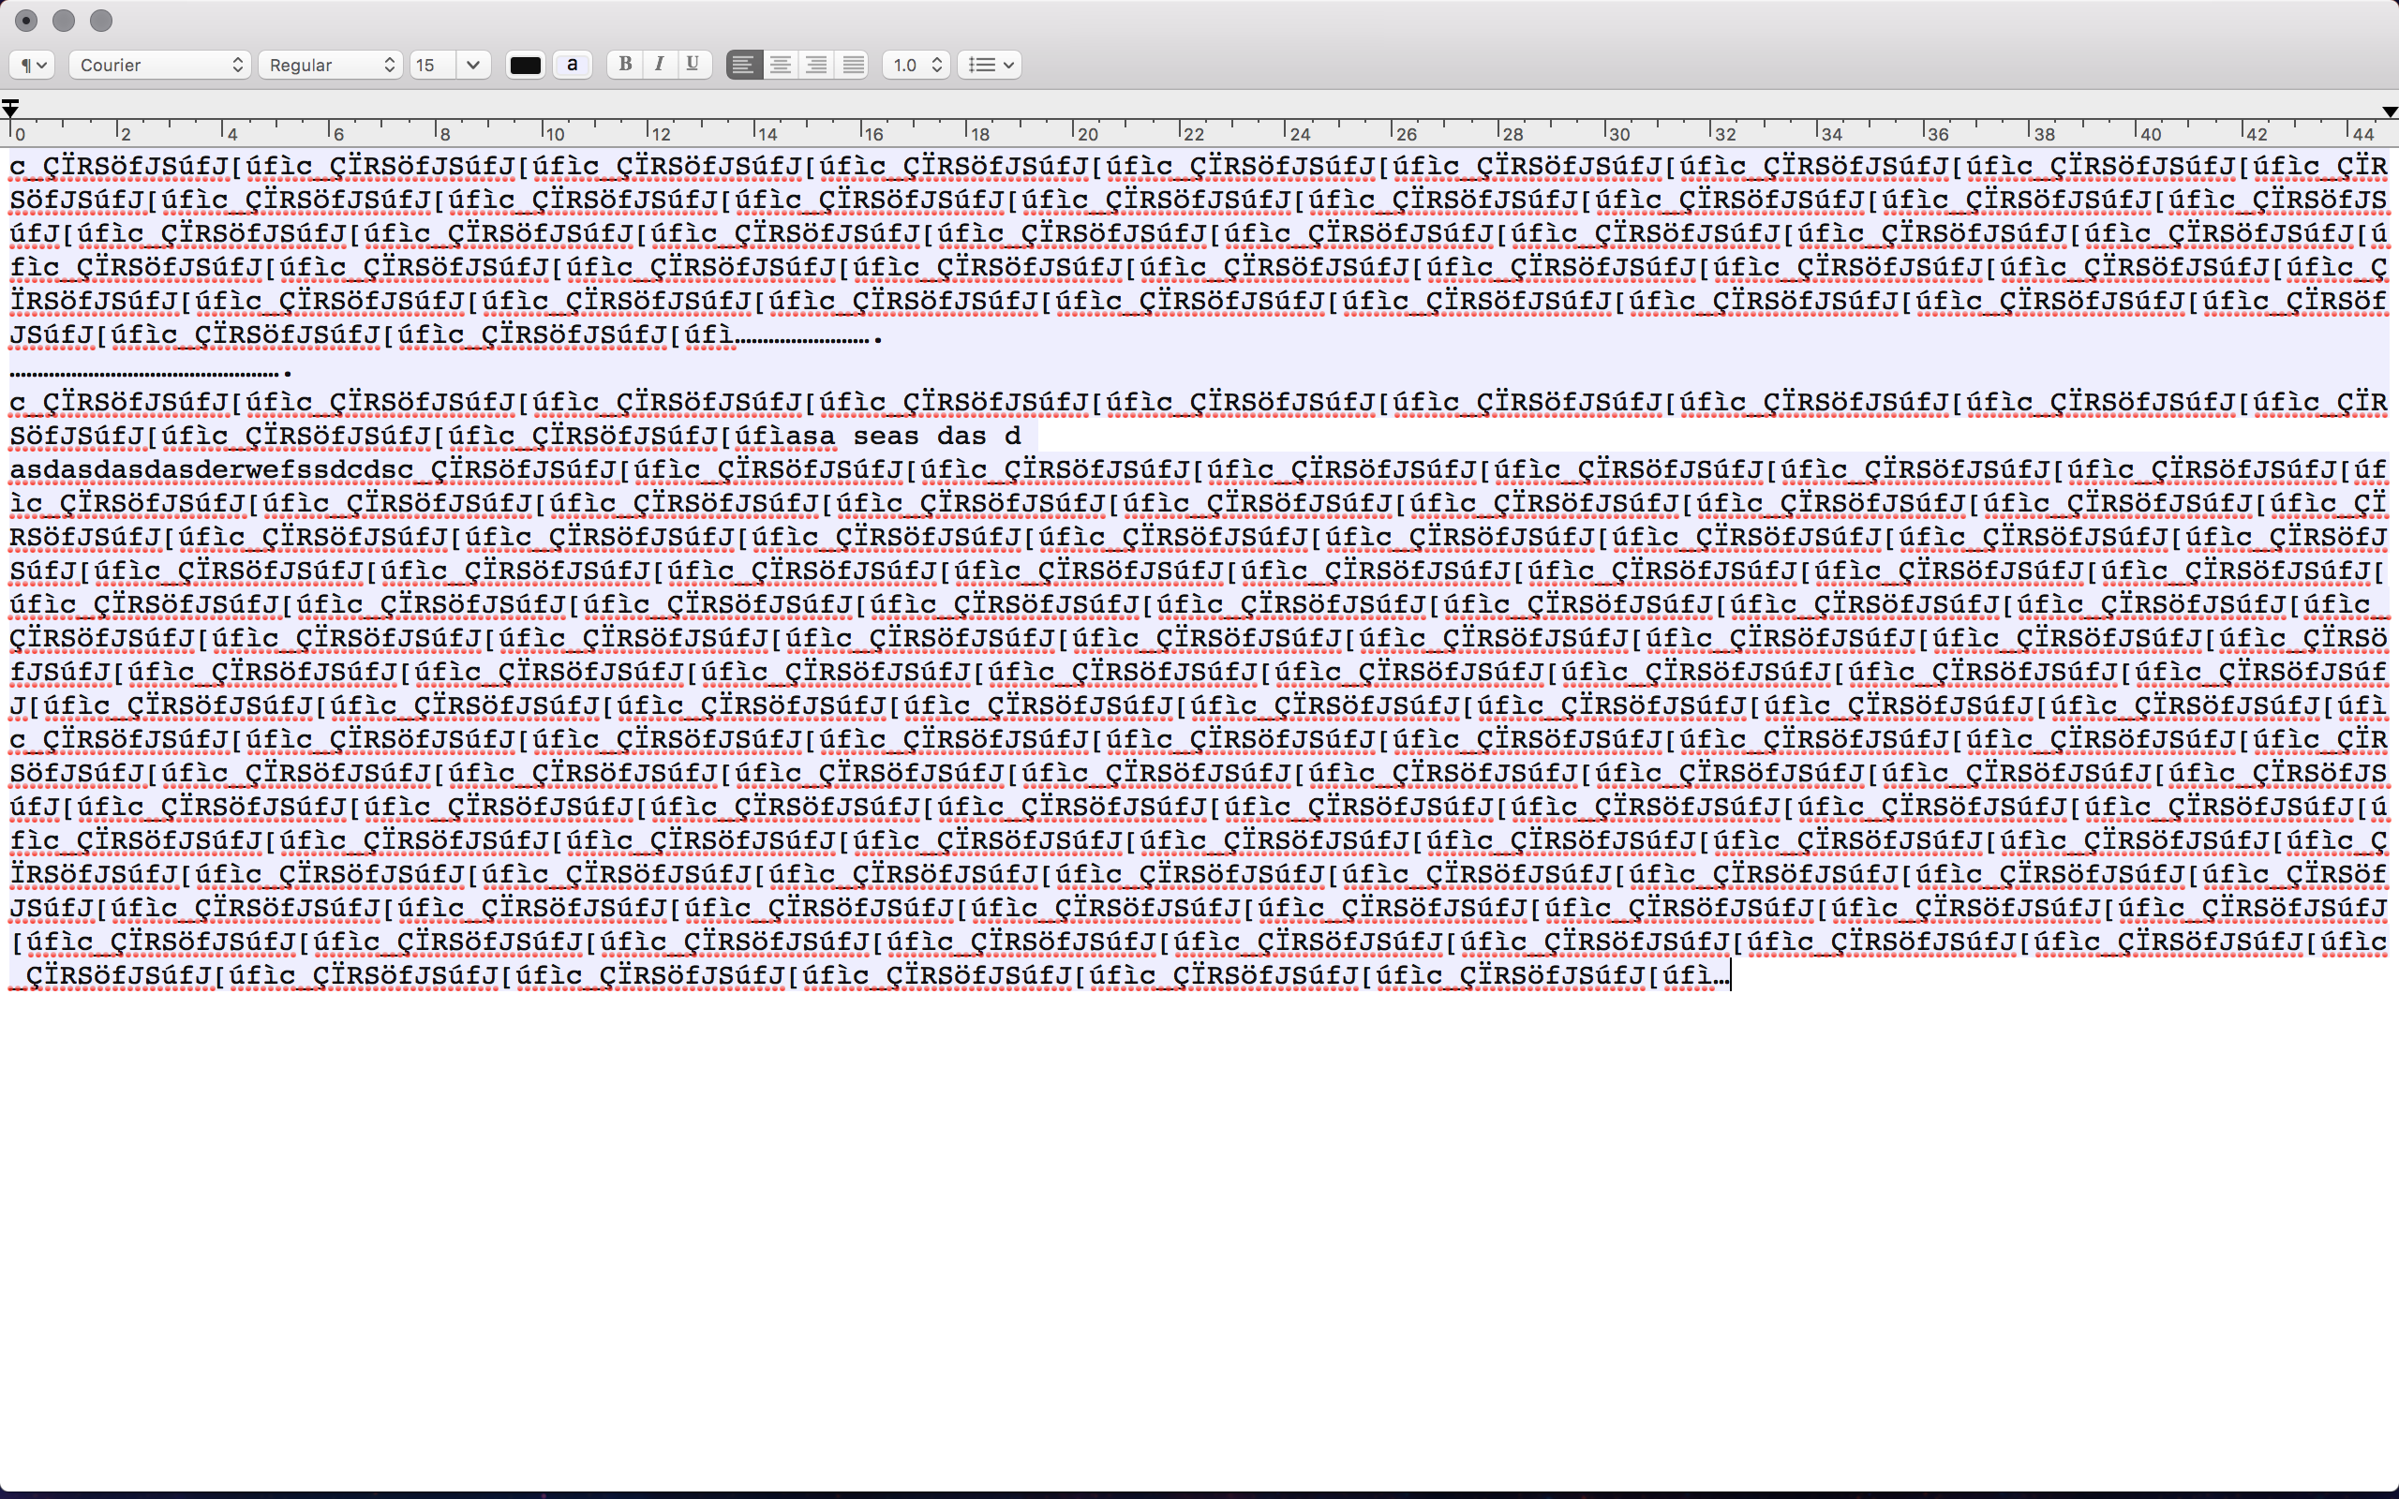
First Experiment
Observation - 1
Though using Arduino powered on the ESP, but all I got was garbage and here beings the second problem which persisted a long way. The reason behind it is ESP is manufactured by a Chinese company and it doesn’t come with an instruction manual and also the company released different versions of same module that ran at various baud rates. Hence due to this and power problem I kept getting bad data as you see in the background. Confused with what was causing it I decided to use MB102.
Back
Source : Self-taken

Slide 28
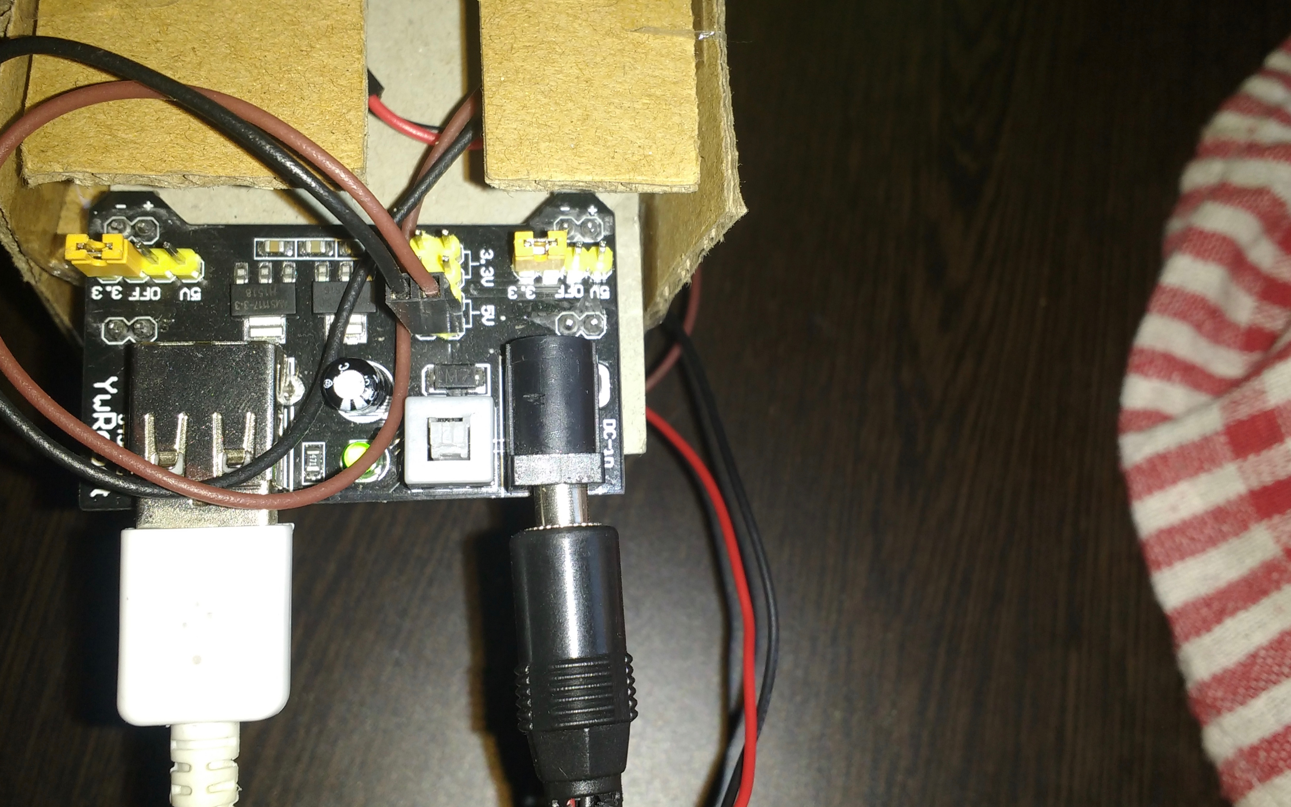
Second Experiment
Observation - 2
Before this I tried to make a voltage-divider circuit but it too didn’t work out. Finally I settled on MB102, which is a breadboard power supply module, at that time it looked like the perfect candidate but unfortunately it didn’t work out as well, still the bad data as output. By this time I figured that bad data output was due to wrong baud-rate and wrong voltage to CH_PD
Back
Source : Self-taken

Slide 29
Source : Self-taken
Third Experiment
Observation – 3
Back
Finally it worked at 9600 Bd (baud-rate) and 1k-ohm resistor pulled between Vcc and power-source.

Slide 30

3.Flashing the right firmware
The Problem with existing firmware
Image Source : http://nodemcu.com
Image Source : http://nodemcu.com
AT Firmware
NodeMCU Firmware
Requires Arduino Support, in this firmware ESP8266 is completely a slave to the arduino and I don’t want that.
With this firmware, ESP8266 is programmable just like an arduino and this completely eliminates the use of arduino in my project. NodeMCU has LUA language support which is very much like python.
Back

Slide 31
The Right Firmware
Solution
NodeMCU
Open-source firmware and development kit
Advanced API for hardware IO
Event driven Network API
Reduce the redundant work for configuring and manipulating hardware
Fast and better support for bugs and fixes
Eliminates the need of Arduino
Advantages of event-driven API
Makes quick decisions / takes actions quickly in response
to an event, for example in ESP8266 if we have to connect to
the nearest router the command would be like this:
print(wifi.sta.getip())
wifi.setmode(wifi.STATION)
wifi.sta.config("SSID","password")
print(wifi.sta.getip())
Image Source : http://nodemcu.com
Back

Slide 32
Solution
I connected ECHO pin on the HC-SR04 to a 1K resistor in line to prevent the HC-SR04 from hurting/rebooting the ESP8266. The HC-SR04 has no problem receiving a 3.3v signal on the TRIG pin, from the ESP8266.
4. Interfacing HCSR-04 with ESP8266
Technical Difficulty
This was a language problem since I was new to LUA and ESP8266 and hence interfacing HCSR-04 was challenging.
ESP8266 worked on 5v any fluctuation in the voltage of ECHO pin would cause the system to reboot.
Back

Slide 33
System Application
Phase - 4
4.1 Data Acquisition OTA
4.2 Storing data for analysis
4.3 Locating Bins in neighborhood
4.4 Finding and visualizing the shortest path
4.5 Predicting the fill level in advance to the pickup
Back

Slide 34
Over The Air (OTA)
Data Acquisition
Step 1: Configure ESP8266
Configure the ESP8266 to connect it to the nearest AP, if it fails then wait and try again. After a successful connection with AP, get the data and post the data to server’s address via a HTTP request.
Send
Step 2: Configure Server

Configure a server that can receive the data sent from from the ESP, I used an APACHE server and MARIA DB to collect the data. Data collected is time-stamped, this can be used for analysis and estimate the condition of the sensor
Show

Step 3: Display Result
Based on the data acquired show the current fill level and percentage of bin filled, height of the bin and other parameters.
Receive
Back

Slide 35
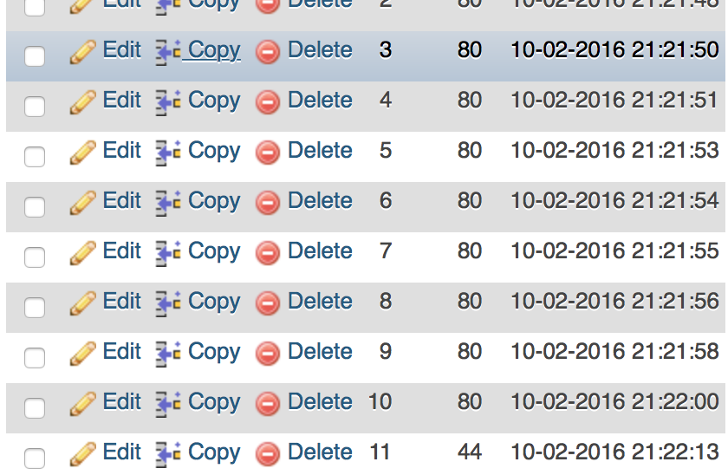
Storing Acquired Data
Maria DB
Maria DB
PHPmyAdmin
PHP scripts are used to store the incoming data from the ESP, the process of storing data is divided into two parts.
Time stamped incoming data is logged in a file.
Time Stamped incoming data is filtered in accordance to height of the bin and this stored in the DB.
MariaDB is a community-developed fork of the MySQL relational database management system intended to remain free under the GNU General Public License.
Back

Slide 36
Locating Bins
MAC-BASED identification
45%
32%
30%
28%
23%
21%
10%
Location_1
Loaction_2
Location_3
Location_4
Location_5
Location_6
Location_7
Can we do it without a GPS ?
The way to do this is, along with the fill data we send the MAC address of the ESP too, assuming that we already the know the location of the bin and it’s not changed since it’s installation, the data received at the server will now be able to tell the location of the bin and this location will be used to route the drivers over an optimized collection path.
Back

Slide 37
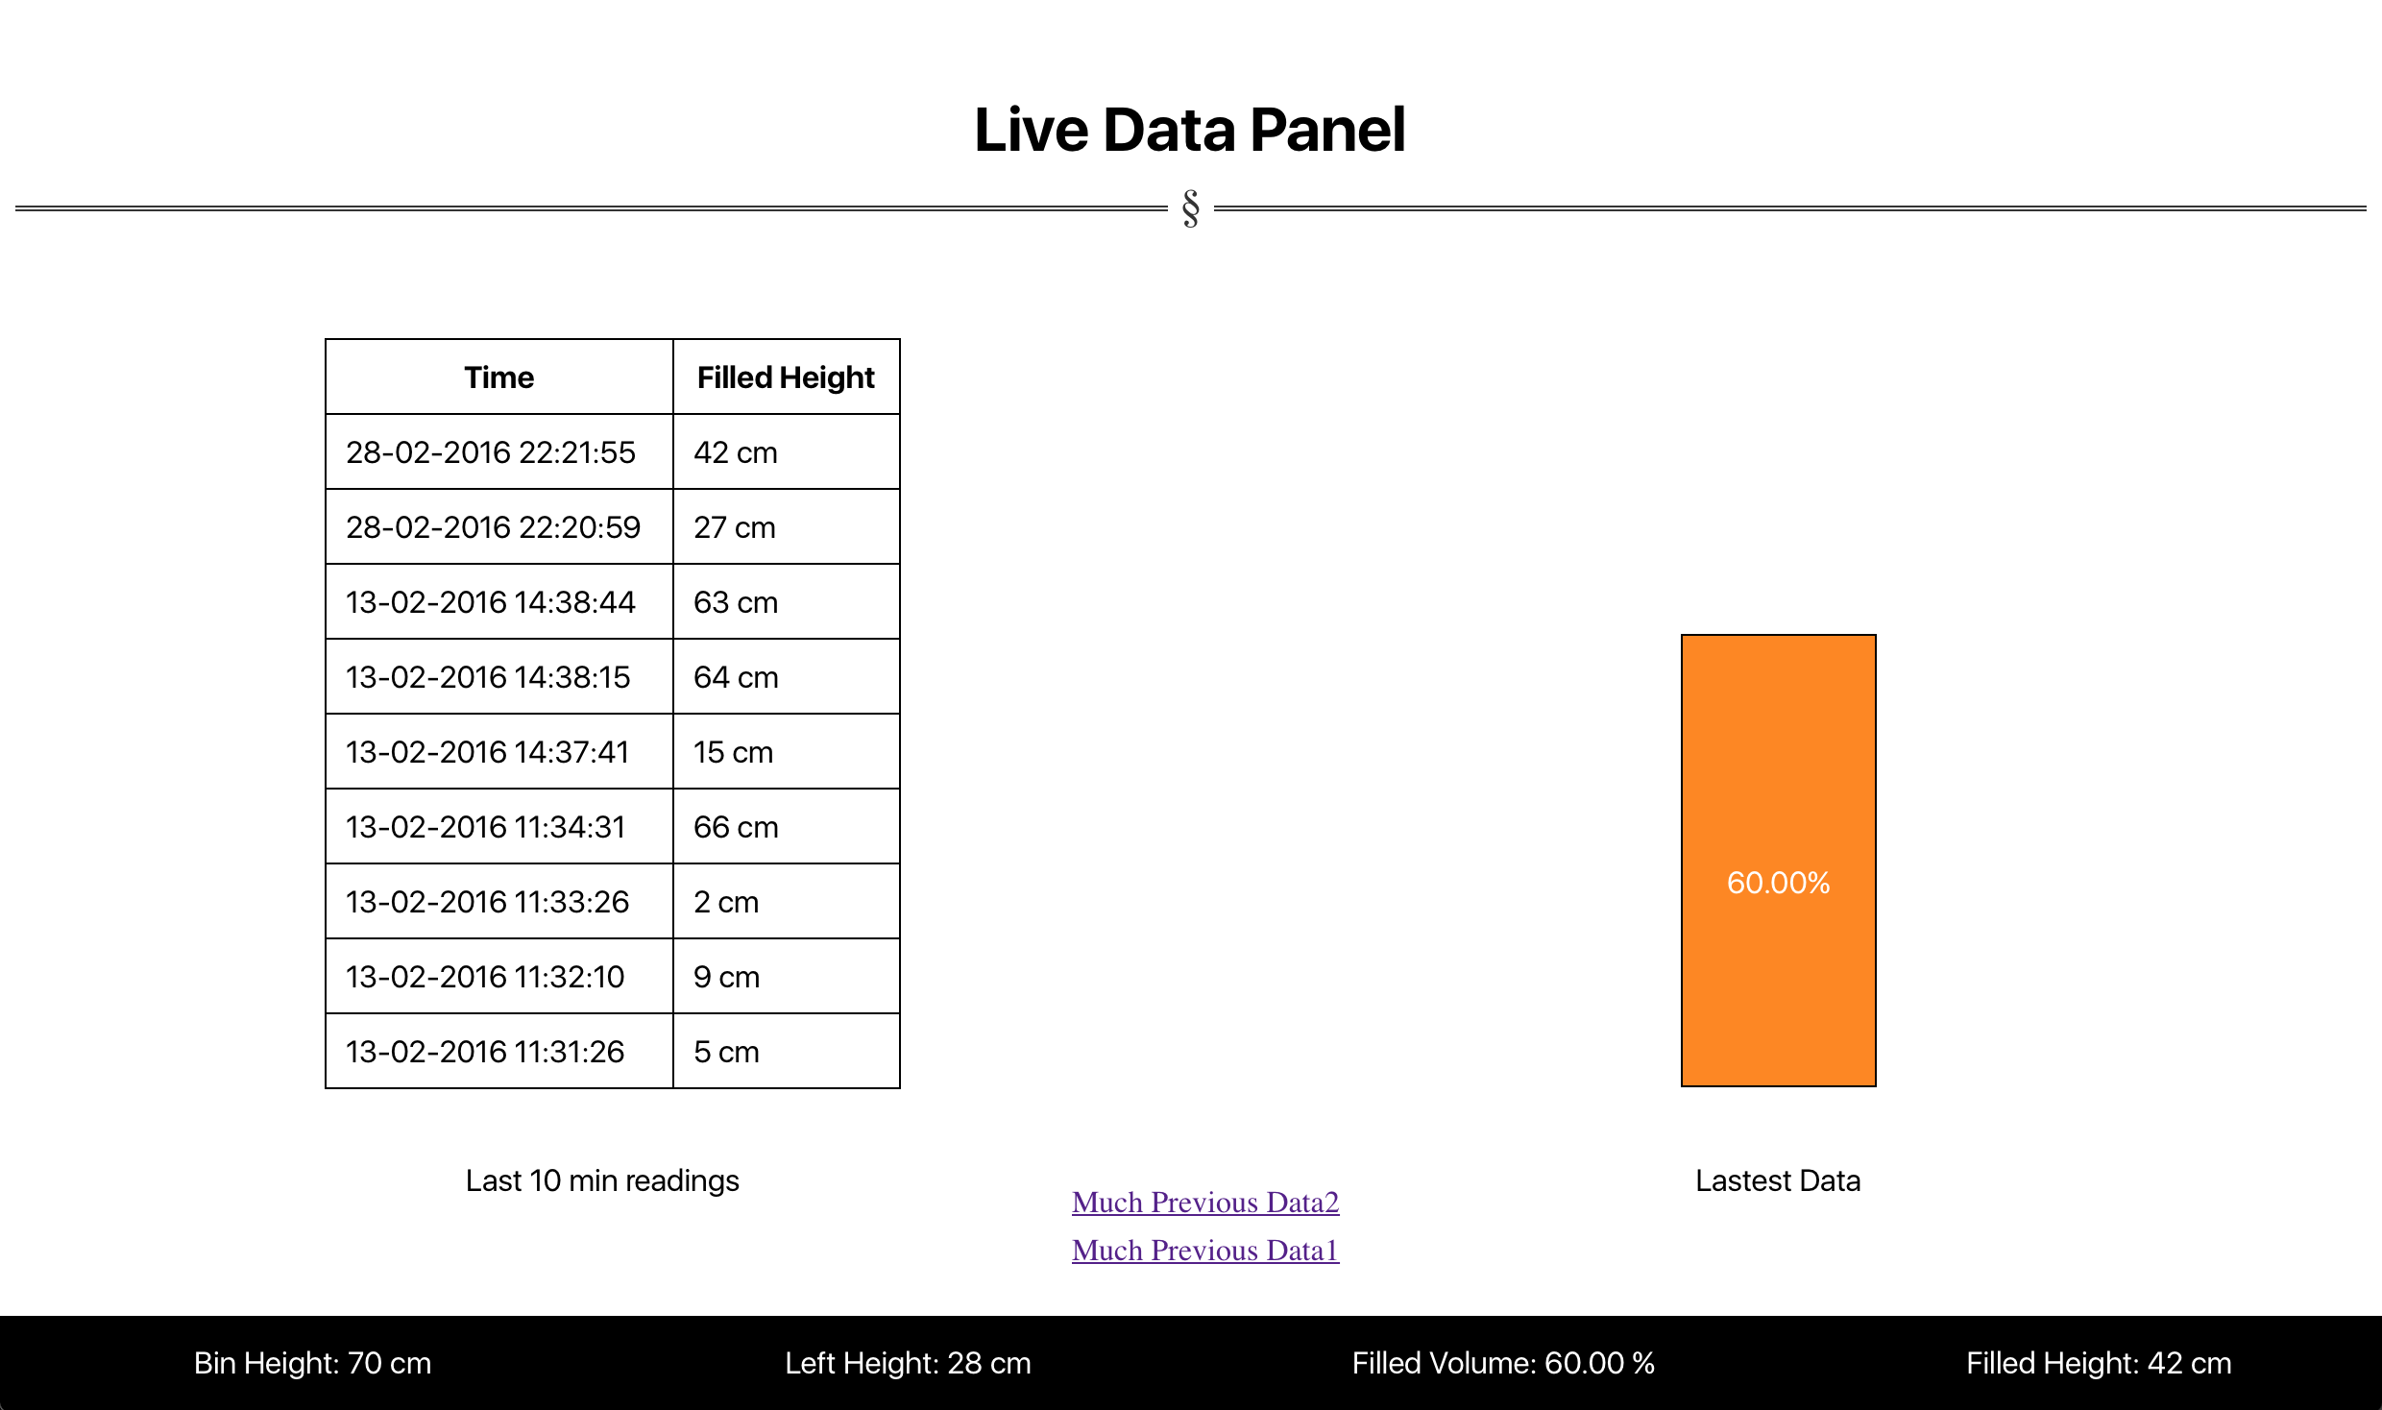
Visualization
The Data acquired recently after the passing the filter is shown here along with the other variables of the bin.
Back

